Slide 1
Business Modeling
Business modeling is a problem analysis technique especially suitable for the IS/IT environment.
The business model is used to help define systems and their applications.
A business use-case model, consisting of actors and use cases, is a model of the intended functions of the business.
A business object model describes the entities that deliver the functionality to realize the business use cases and how these entities interact.

Slide 2
broader set of questions
Why build a system at all?
Where should it be located?
How can we determine what functionality is optimum to locate on a particular node in the system?
When should we use manual-processing steps or workarounds?
When should we consider restructuring the organization itself in order to solve the problem?

Slide 3
purpose of business modeling
1. To understand the structure and dynamics of the existing organization
2. To ensure that customers, end users, and developers have a common understanding of the organization
3. To understand how to deploy new systems to facilitate productivity and which existing systems may be affected by that new system

Slide 4
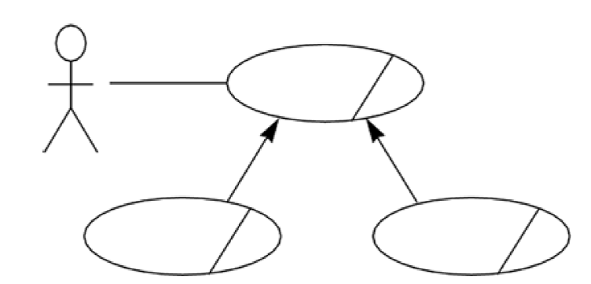
Business use-case model
business-level use case

Slide 5
Examples of a business use-case
"Deliver electronic pay stub to employee."
"Meet with customer to negotiate contract terms."

Slide 6
Examples of business actors
"Customer"
"Employee"
"Software developer"

Slide 7
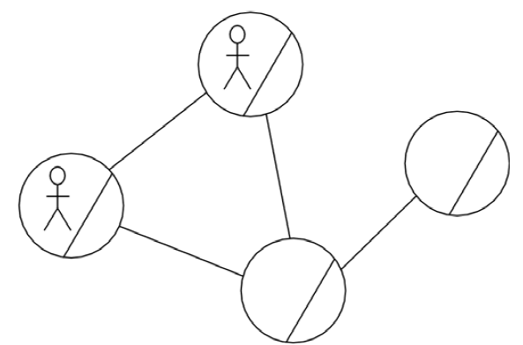
Business object model
business entity
Business worker
e.g. departments, paychecks, systems
e.g. payroll clerk or a system administrator
It may also include business use-case realizations.

Slide 8
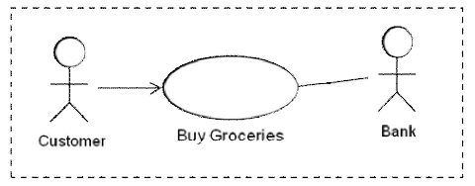
Example Business Use Case (BUC)

Slide 9
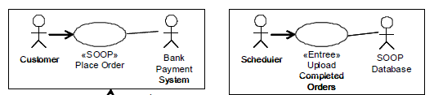
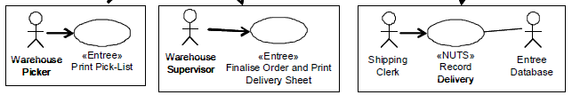
System Use Case (SUC)/comparison with BUC

Slide 10
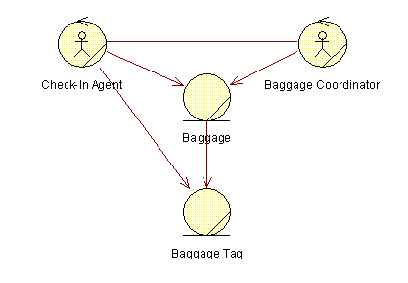
Business Object Model (BOM)

Slide 11
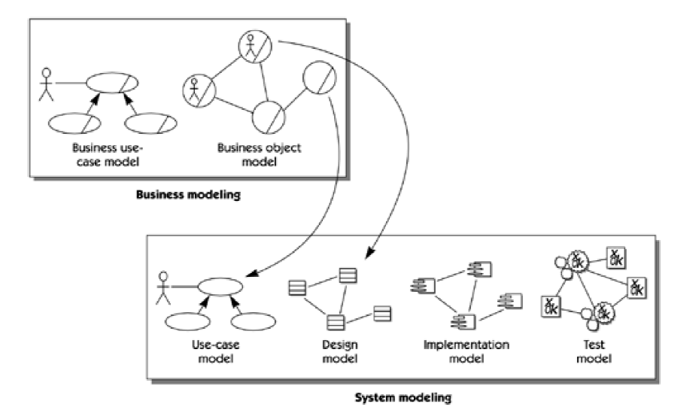
From the Business Model to the Systems Model

Slide 12
The translation
Business workers will become actors on the system we are developing.
Behaviors described for business workers are things that can be automated, so they help us find system use cases and define needed functionality.
Business entities are things we may want the system to help us maintain, so they help us find entity classes in the analysis model of the system.

